Slide 1

Summer Internship FINAL Review
- Kiran Patil

Slide 2
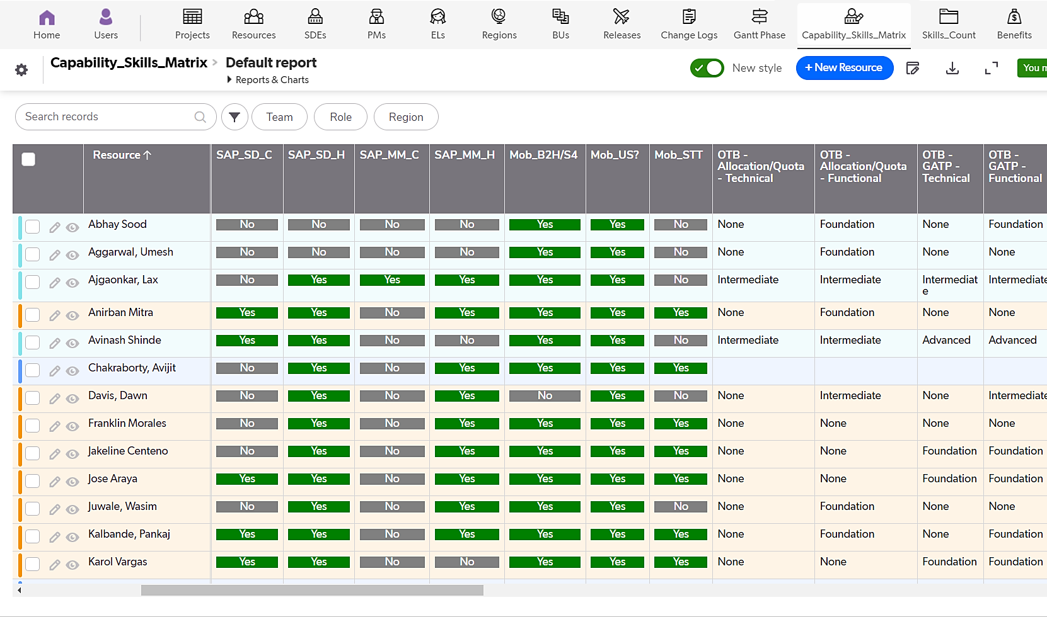


Project 1: Capability Skills Matrix (NCLC)
​
Description :To stay competitive in the industry We need Recourse capability skills matrix with their proficiency level.
Objective : ​
​​Team Skills Repository
Identify skill gaps.
Outcome: ​
Build an App that will enable resource capture, Skills Summary & Proficiency.
Benefits :
​Identify & understand specific skill gaps, individual learning interests within the team.
Better allocation of the resources
Mike Tom
Alice Bron
Kevin Peter
Glen Max
Nick Joe
Mitch Cam
Harry Pot
Jos Englis
Barry Smith
K N Vilims
Philips
Brandon M

Slide 3
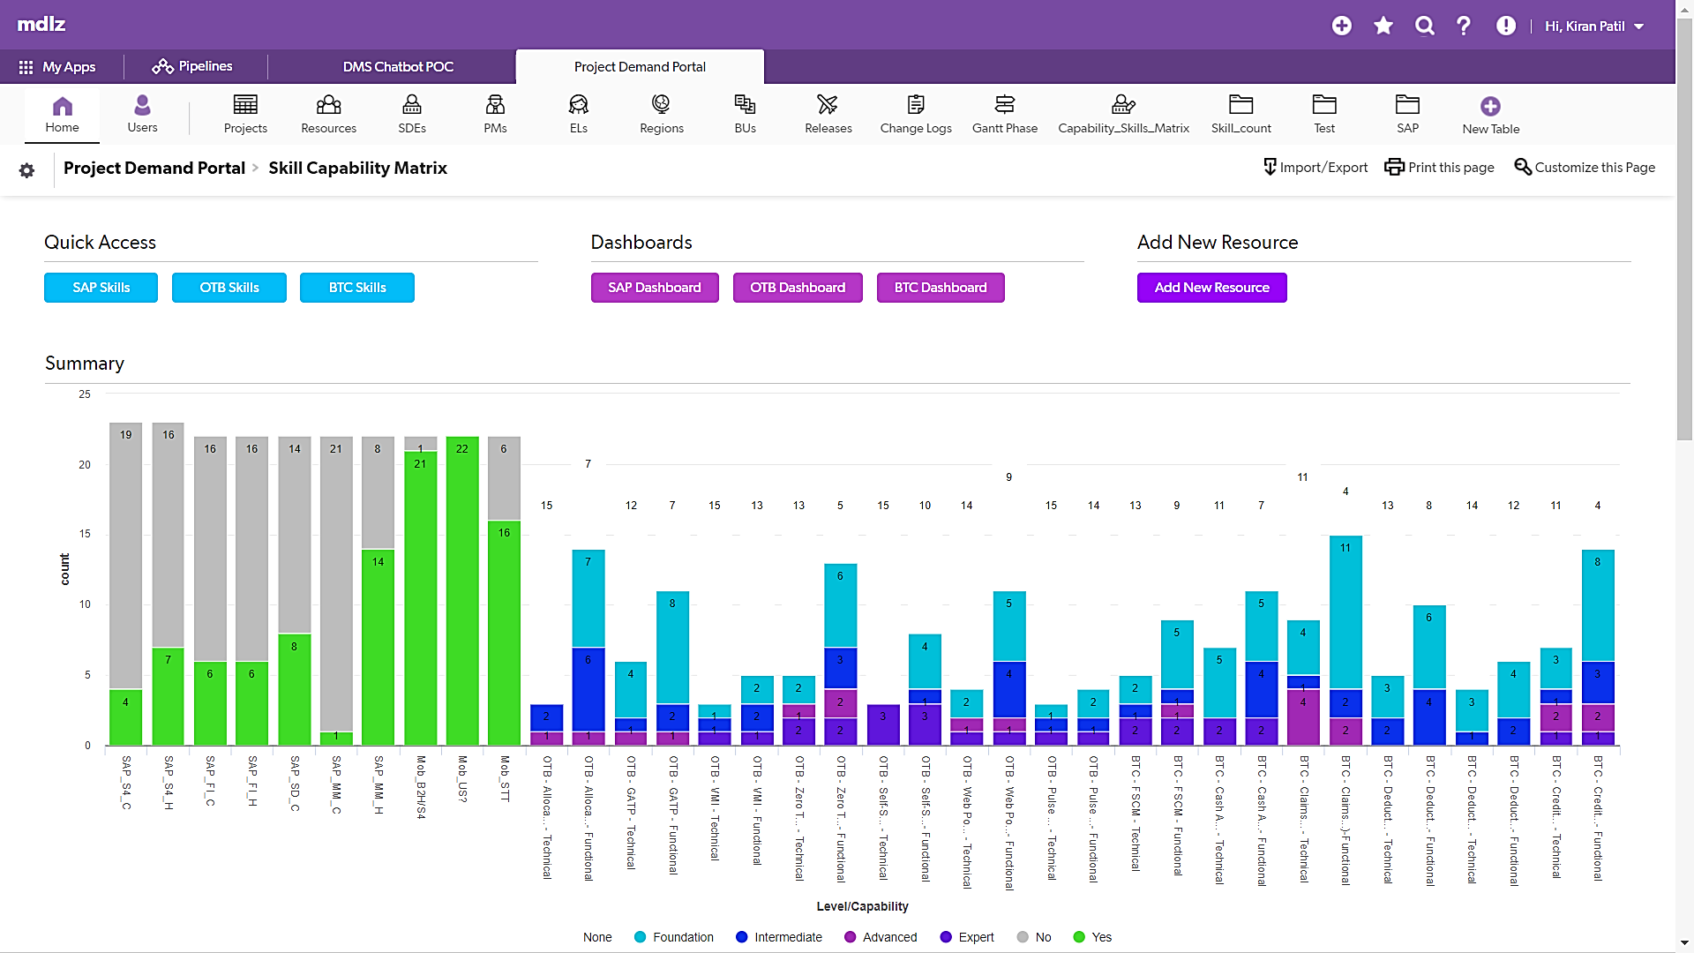

Project 1: Capability Skills Matrix (NCLC)

Slide 4
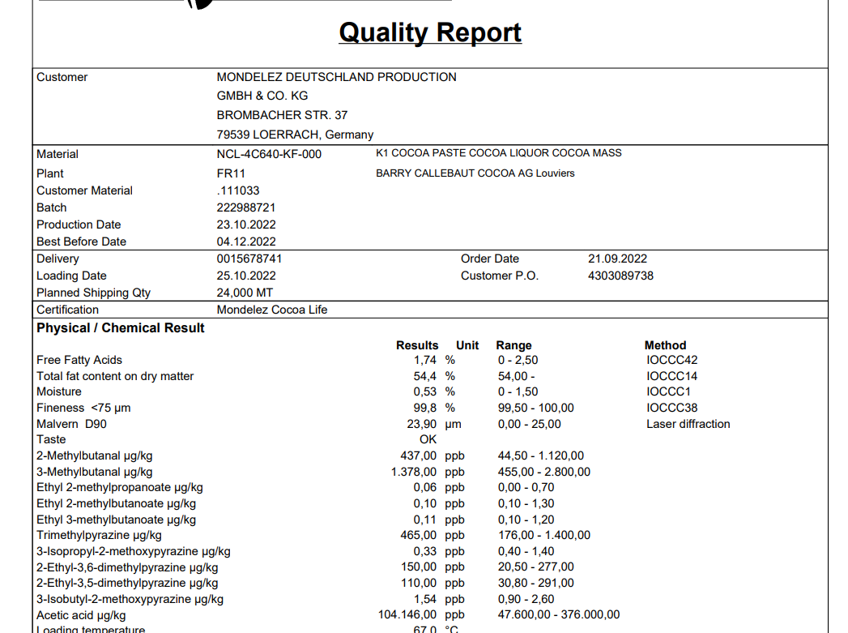
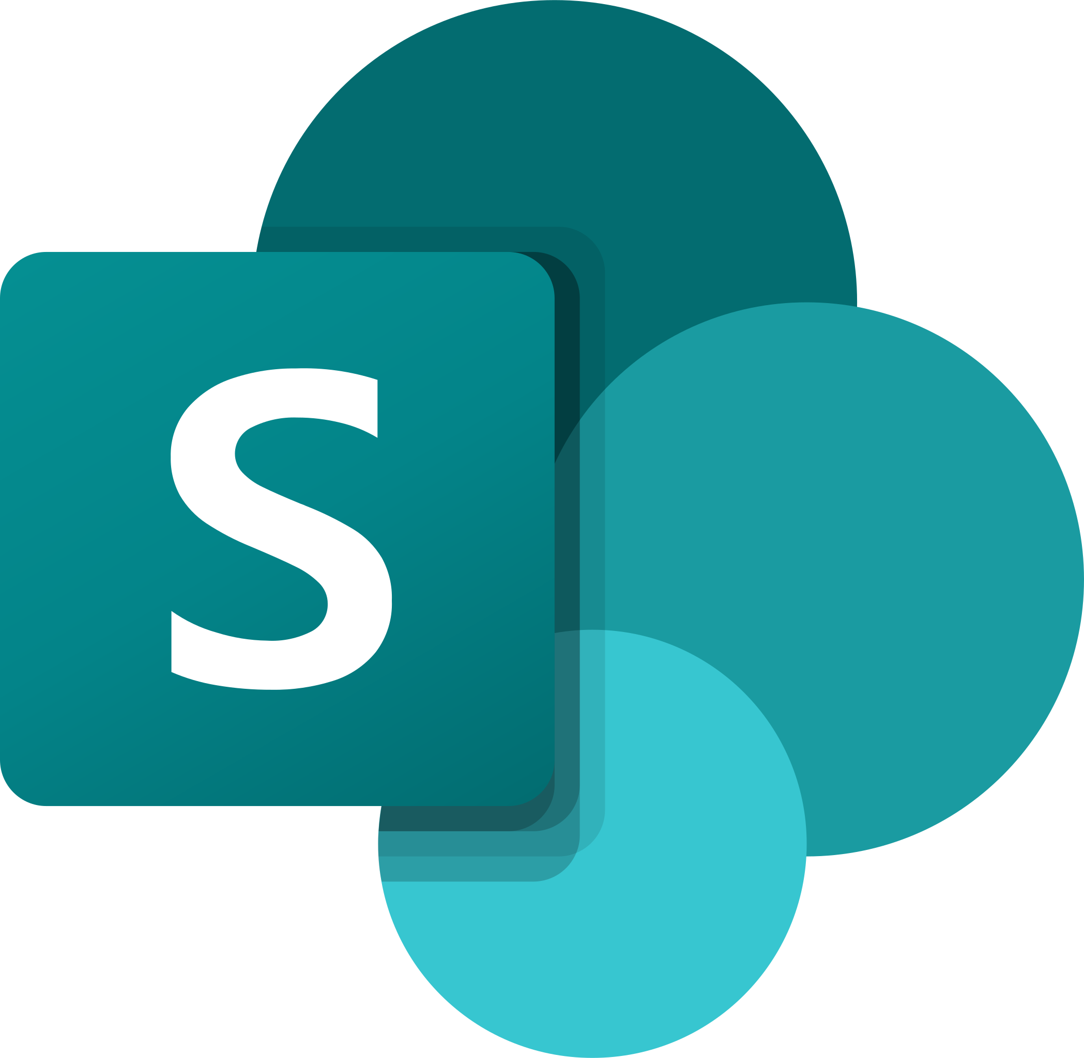


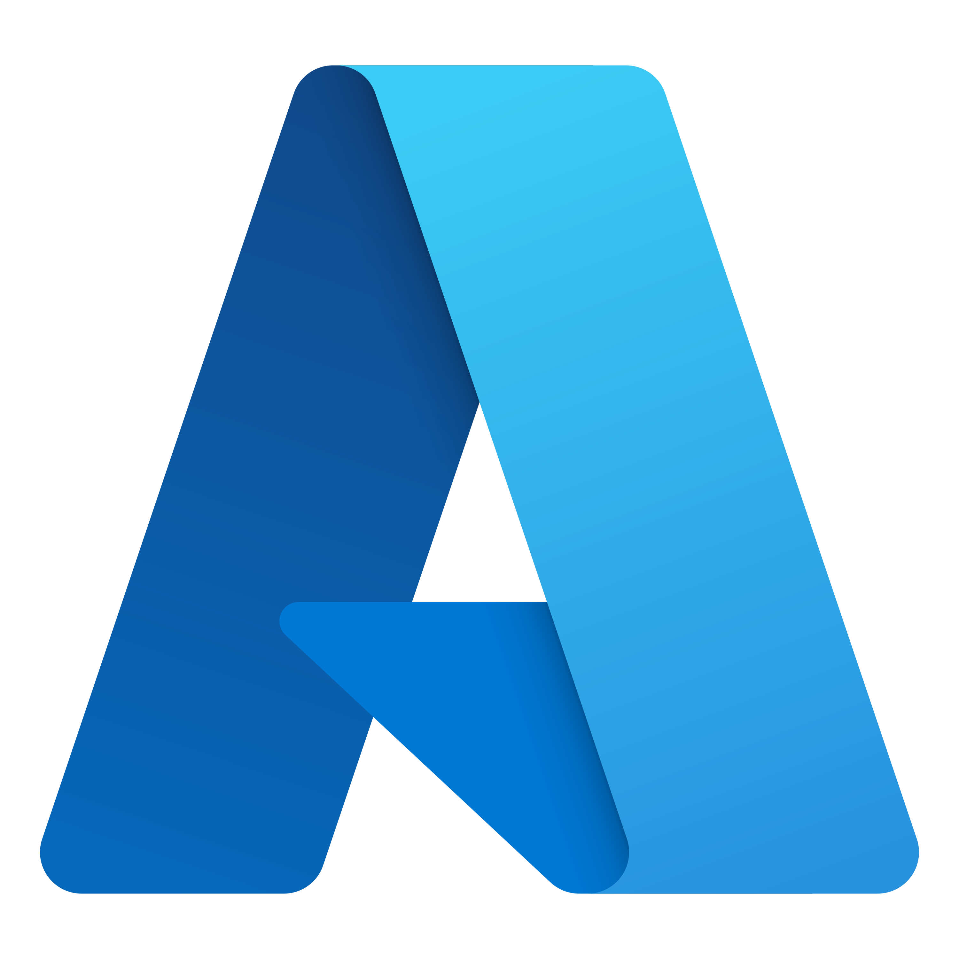
Project 2: AUTOCOA POC ( NLP )
Description : The raw material provider come up with COA’s along with material and the quality analysis team manually verify it with master data whether its parameters are permissible or not
Objective :
Automate the process of COA of raw material to be used across all the regions.
​Outcome: ​
Automate COA process
Save time and efforts and cost.
.
AUTOCOA POC (NLP), NCLC Platform

Slide 5
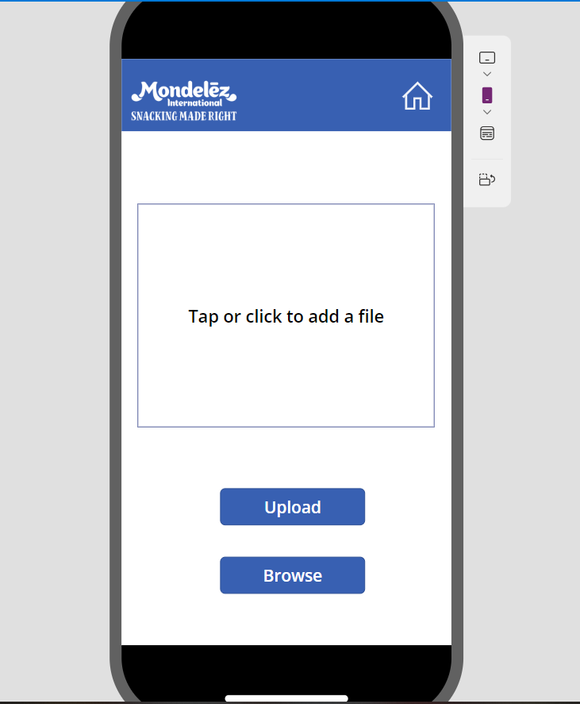
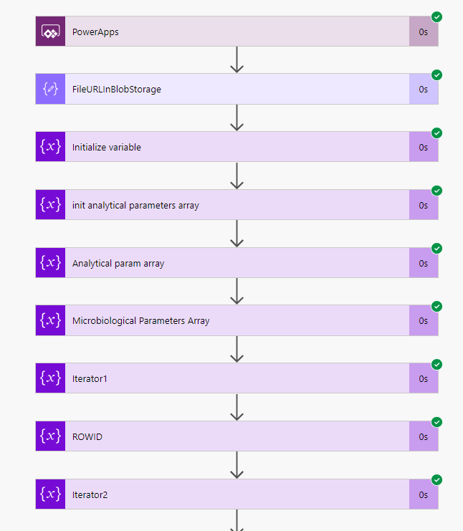
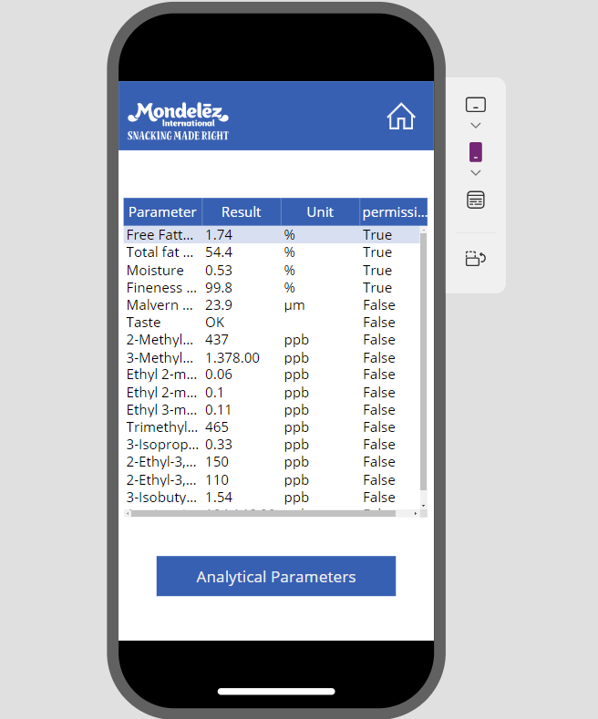

Project 2: AUTOCOA POC ( NLP )
Azure AI services
Form Recognizer

Slide 6
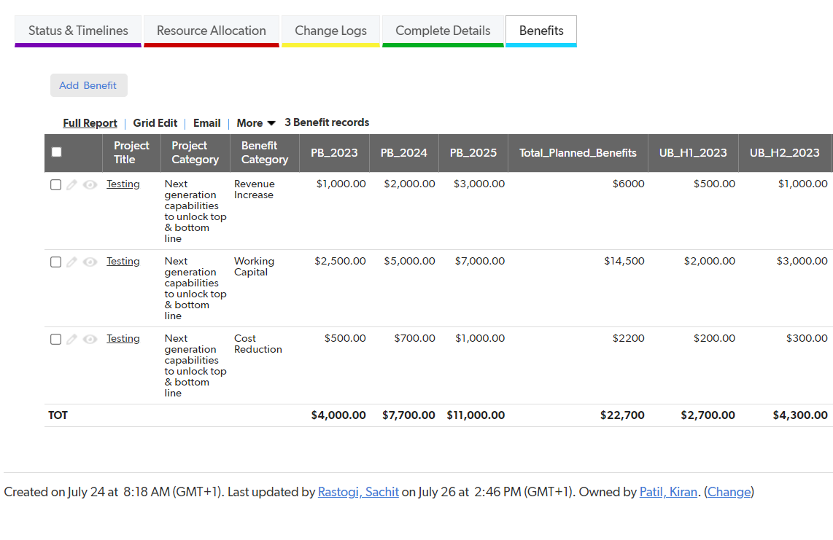
Project 3: BENEFITS TRACKING (NCLC)
Description : There are various projects going on we track them into the Demand tool also wanted to track benefits of these projects.
Objective: ​
To enhance the demand tool to capture the value and benefit
Benefits :
Better capture the value and benefit
Performance Evaluation
Continuous improvement
Risk Management
Project 3 : Benefits Tracking

Slide 7
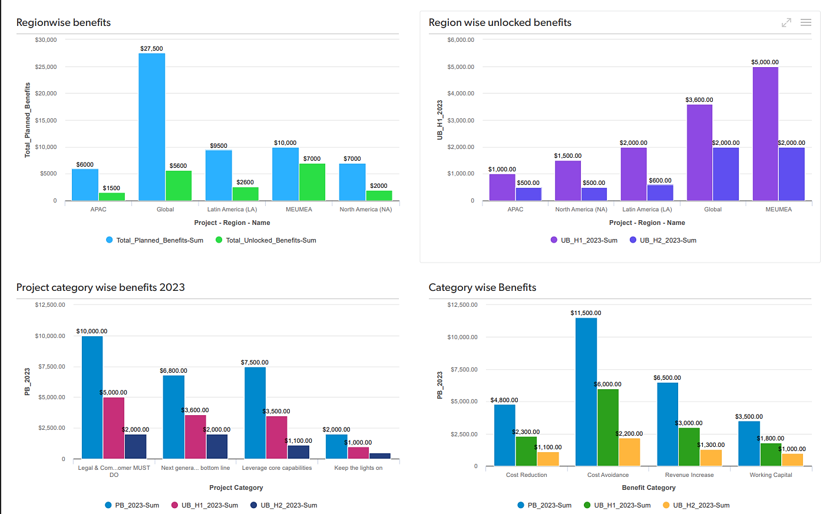
Project 3: BENEFITS TRACKING (NCLC)
REPORTING OF BENEFITS

Slide 8
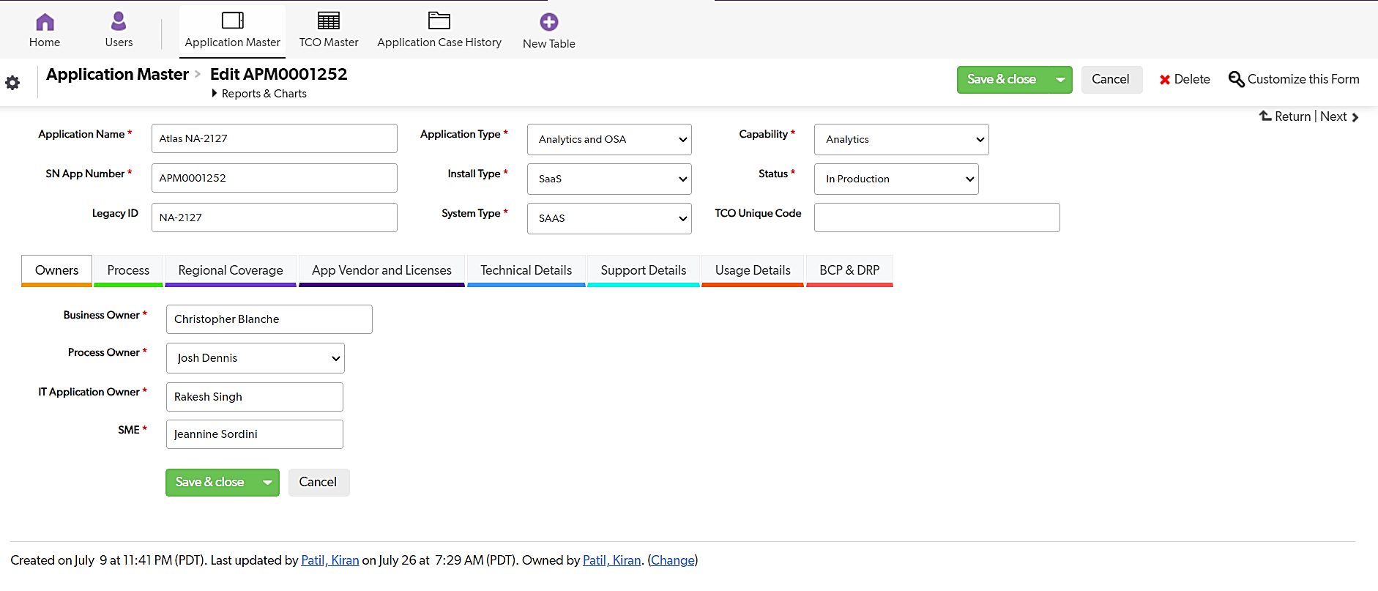
Project 4: TCO Application (NCLC)
Description :
TCO is an app to store and track all Applications, Purchase Orders, Vendor details, and other relevant details.​
Objective: ​
To simplify the process and move away from the conventional excel based tracking.
Benefits :
Improved efficiency, Better data management.
Mobility
Project 4 : TCO App

Slide 9
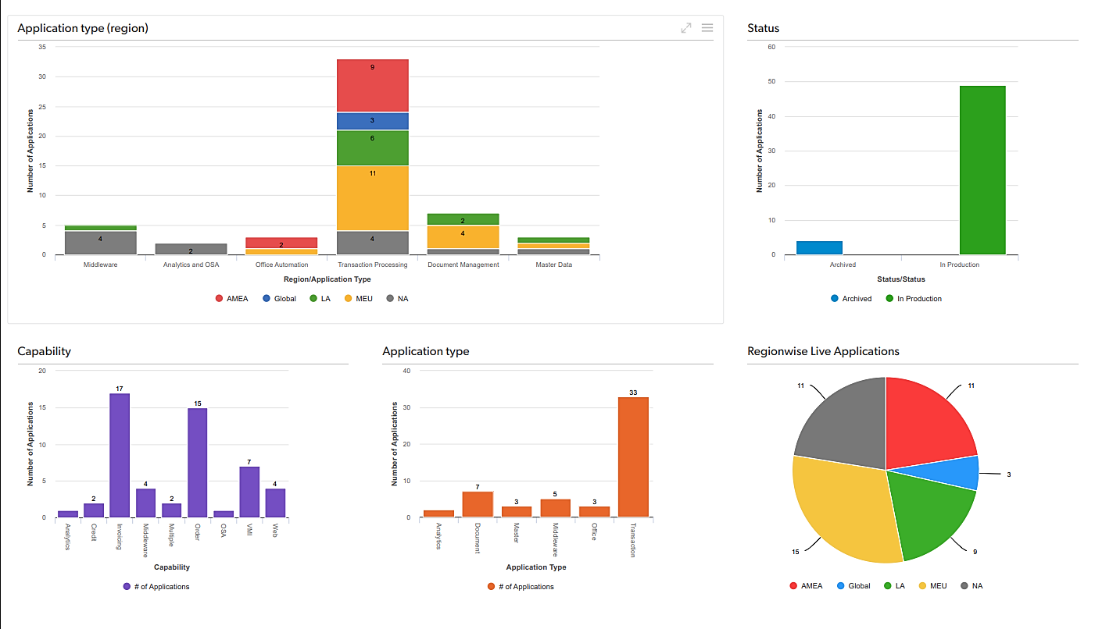
Project 4: TCO Application (NCLC)
TCO App Dashboard

Slide 10
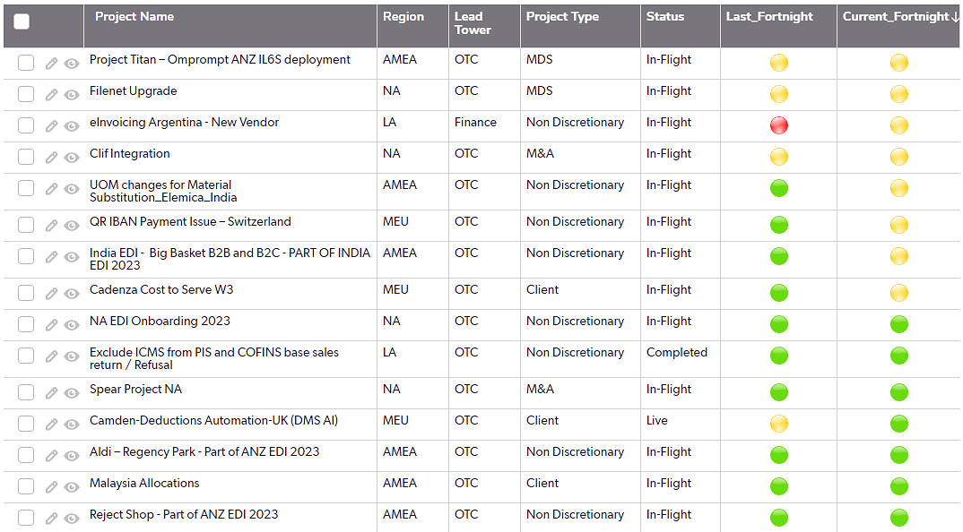
Project 5: Project Reporting app (NCLC)
Description : ​
Automate Graphs and Issue summary generation from weekly status table on Quick base .
Objective : ​
To assess the weekly status of live and in-flight projects with the help of various graphs visually with a help of dashboard.
Benefits :
It's time saving and gives us real time insights with the help of enhanced data visualization and results into increased productivity.​
Current Fortnight vs Last Fortnight
Test 1
Test 2
Test 3
Test 4
Test 5
Test 6
Test 7
Test 8
Test 9
Test 10
Test 11
Test 12
Test 13
Test 14

Slide 11
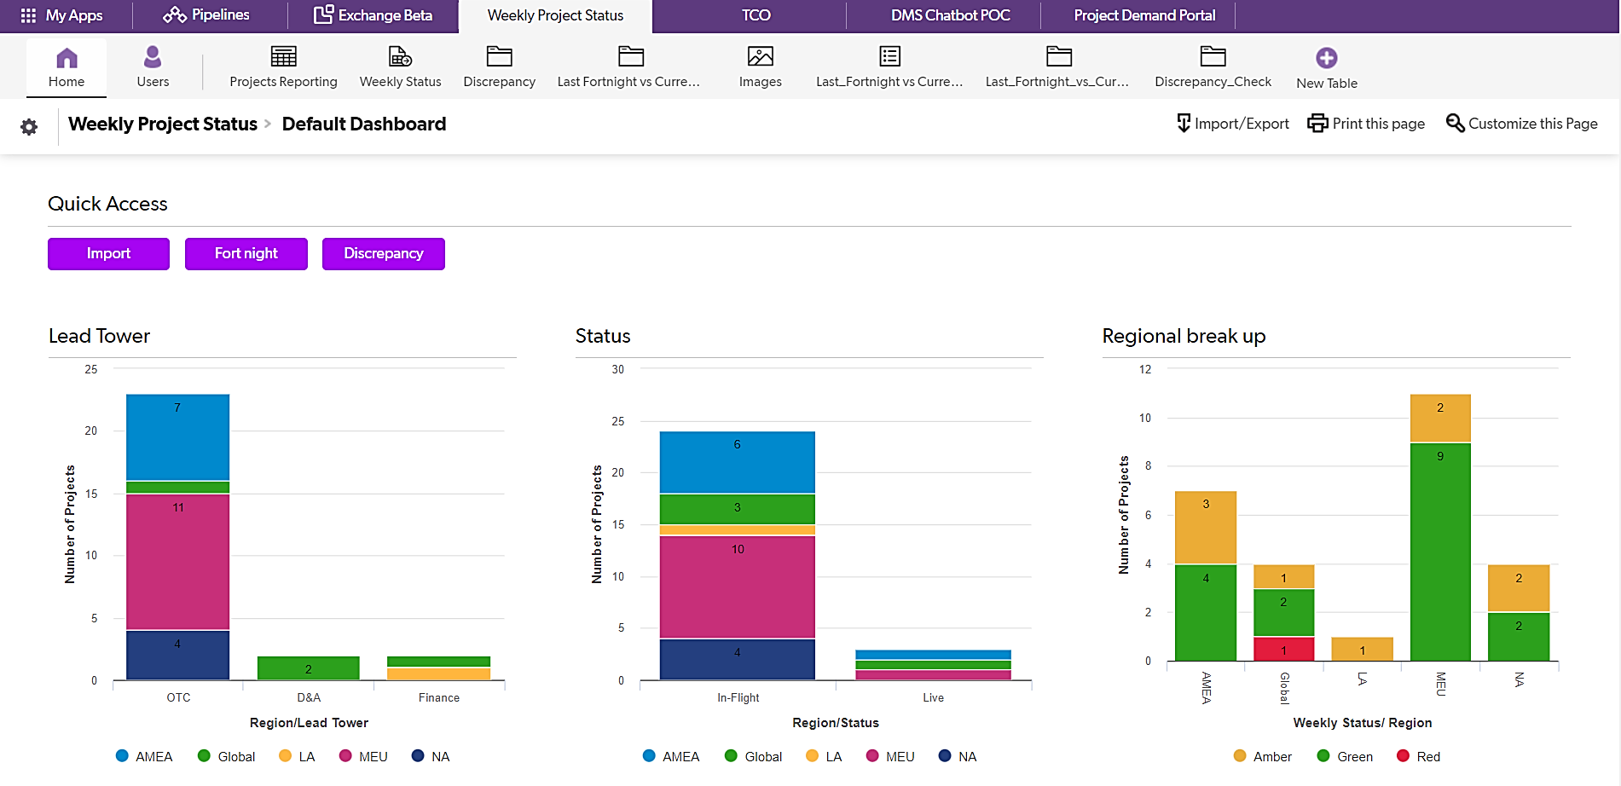
Project 5: Project Reporting app (NCLC)
Project Reporting App Dashboard

Slide 12
Learnings & stakeholders
Learnings
NCLC Platforms : QB
Microsoft power platforms
AI Builder
Azure Form Recognizer
NLP
Data Pipelines
Dashboards
Experience
Corporate Experience
Collaboration
Adaptability
Dealing with complexity
Practical Application
Teamwork
​
Comments
I had really enjoyed my time at Mondelez. It was a fantastic learning experience that I will cherish throught my career.

Slide 13
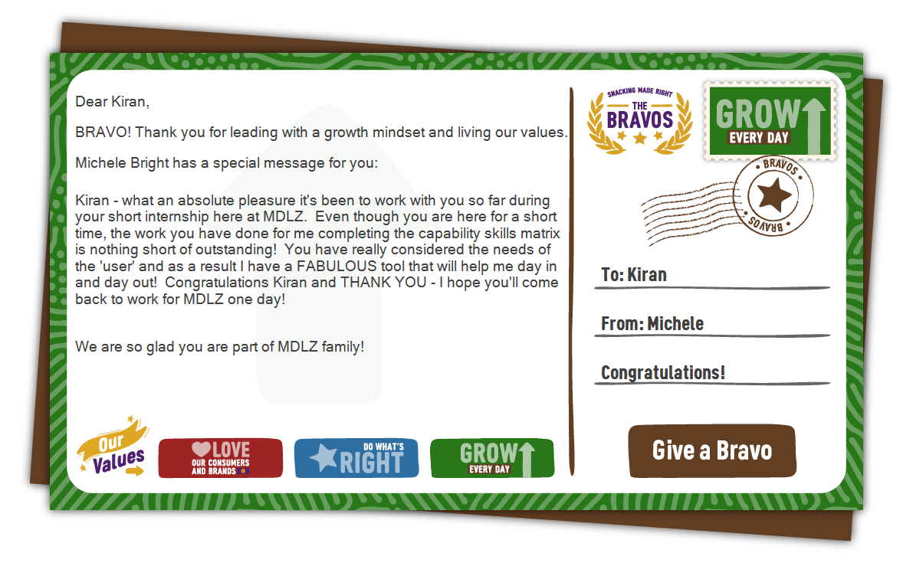
aCHIVEMENTS

Slide 14
Thank you!

